Slide 1
Air Quality – L4
Virendra Sethi
vsethi@iitb.ac.in
7809

Slide 2
Mixing/Dispersion
Meteorology
  Vertical
    Temperature
      Lapse Rate
  Horizontal
    Wind
      Speed
      Direction

Slide 3
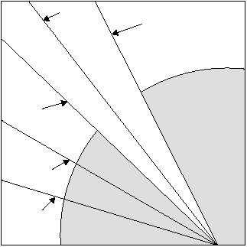
Stability
Average
Wet Lapse Rate
Dry Lapse Rate
Stable
Height ↑
Unstable
Temperature
http://www.tpub.com/content/aerographer/14312/css/14312_47.htm

Slide 4
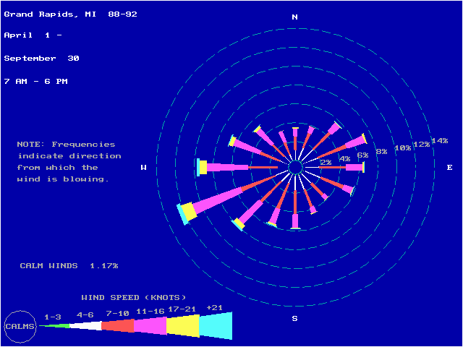
Wind Rose
1 knot = 1.82 km/hr
http://www.epa.gov/ttn/naaqs/ozone/areas/wind.htm#dlfi

Slide 5
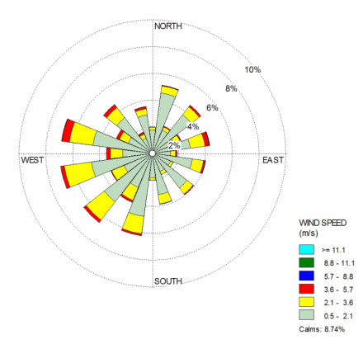
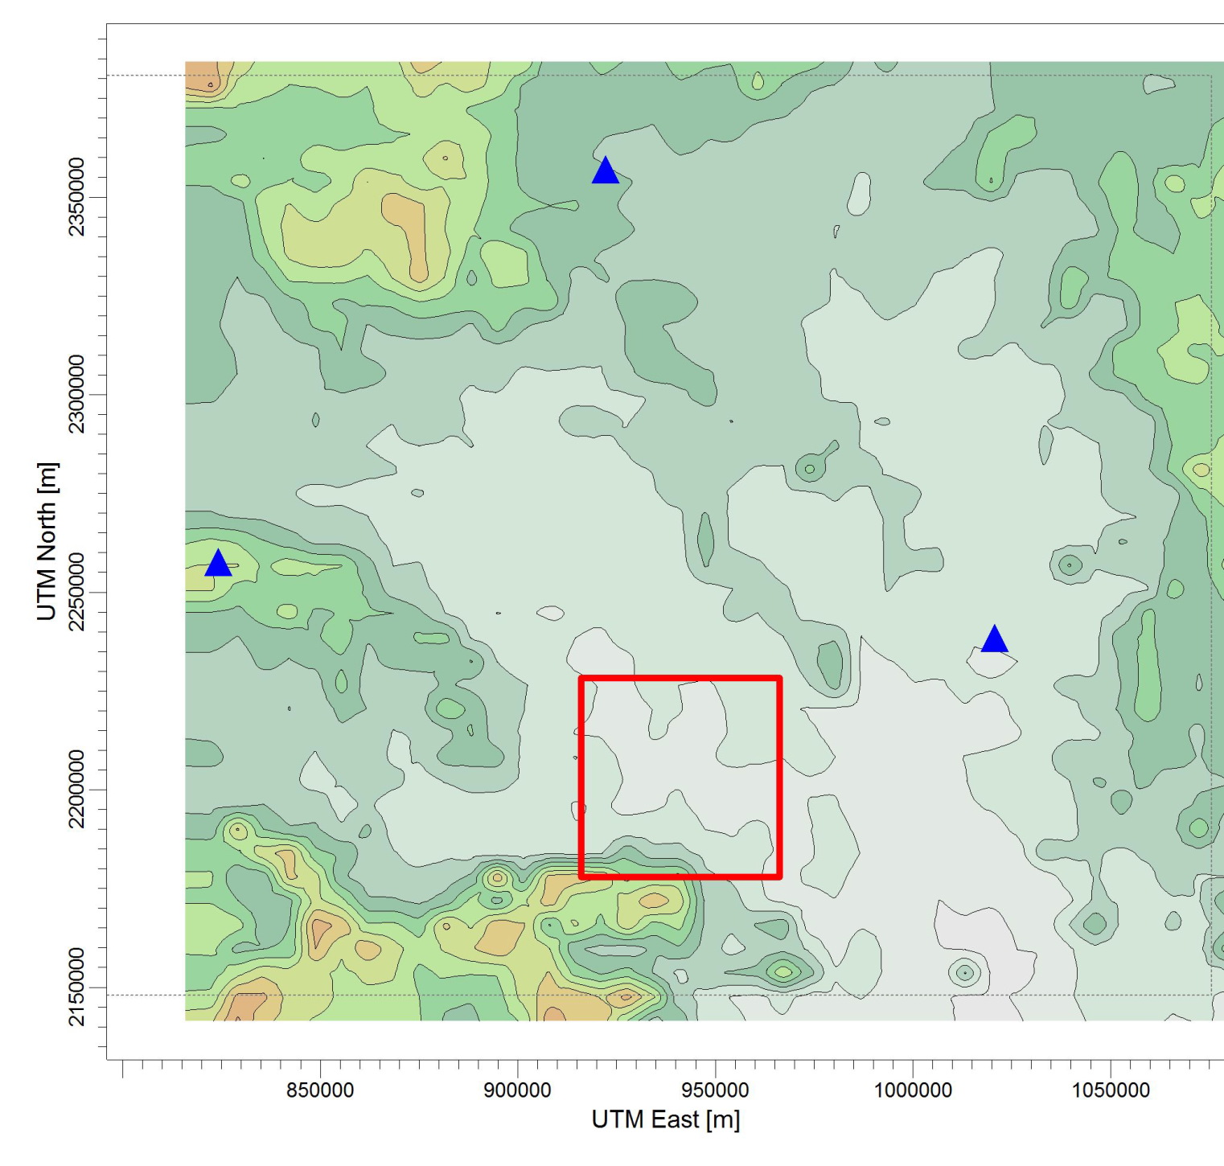
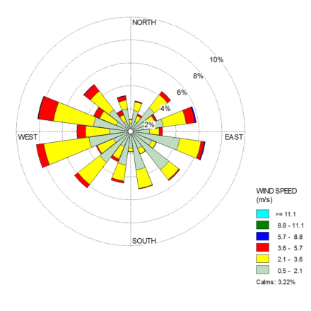
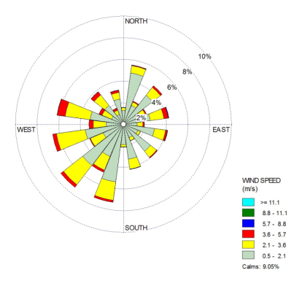
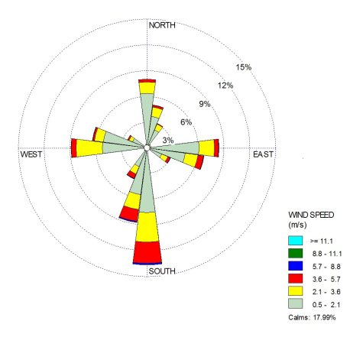
Wind conditions at 3 IMD Stations and CSTPS in Chandrapur
Nagpur
Similar
Similar
Similar
Yavatmal
Similar
Gadchiroli
Different
CSTPS
Chandrapur

Slide 6
Gentle Reminder

Slide 7
GAME BEING PLAYED
YOU are
Accountable for Air Quality in
Your City

Slide 8
Nature of Air Pollutants
Gaseous
2. Particulate Matter (PM)

Slide 9
NAAQS
National Ambient Air Quality Standards
CPCB Website :
cpcb.nic.in/air-quality-standard/

Slide 10
Air Pollution
Concentration
  mass of pollutant / volume of air
  number of particles / volume of air
  opacity
Duration – hours to days to years
Some Criteria Pollutants
  Primary
    SOx
    NOx
    CO
    PM-10
    Particulate Lead
  Secondary
    Ozone

Slide 11
How do you measure the mass concentration of PM ?
Δm/Qt
t
Δm
Q
Flow Meter
Vacuum Pump
Polluted Area/Space
Filter Cartridge

Slide 12
Gaseous Pollutants
Similar sized molecules
Behaviour
  Physics : Same
  Chemistry : Different
    EXAMPLES
      Solubility
      Toxicity
      Ozone Depletion Potential

Slide 13
Particulate Pollutants
Behaviour
  Physics : NOT the same
    Size
    Morphology
  Chemistry :
    Inert (Sand)
    Smoke (Toxic, intoxicating)

Slide 14
Perception
(Scales)

Slide 15
2 m
Elephant
2 mm
Ant
3 Orders of Magnitude

Slide 16
Ants and Elephants
Ant ~2mm
Spherical Baby Elephant ~2 m
  Order of magnitude 3
Nitrogen Molecule 0.3 nm
Respirable particle ~300 nm
  Order of magnitude 3

Slide 17
Particles in Air
Are like
Elephants
Suspended
in an
Ocean of Ants

Slide 18
Ants and Elephants
All the well established physics of “ants” (IDEAL GAS) is not applicable to the “elephants”
All the MAGIC of “nano” is in this “new” world of “elephants”
Ability to understand this range of sizes has become possible due to development of instrumentation
Last three decades have been exciting times for Aerosol Science and Engineering
  Powder Production – Material science
  Nano-products
  Atmospheric Pollutants
  Medical Sciences

Slide 19
Even within the entire range of sizes of Particulate Matter
Size decides
WHERE they would deposit in the lungs

Slide 20
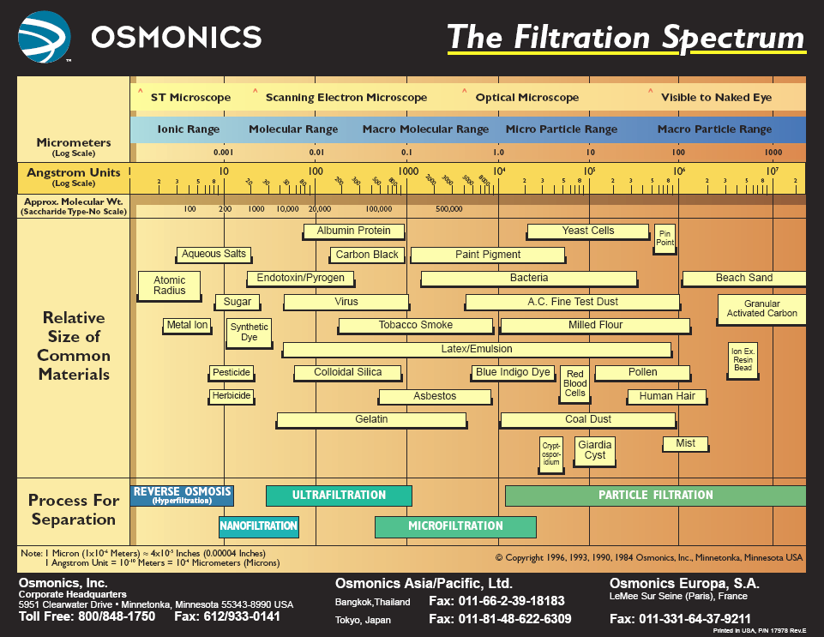
Respirable
Stopped in Nose

Slide 21
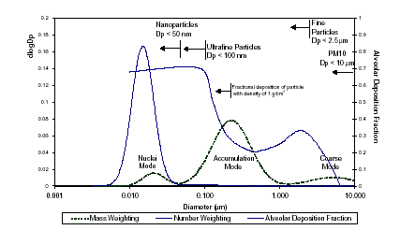
Tri-modal Particle Size Distribution
Typical Engine Exhaust Size Distribution both Mass and Number Weightings (Source: Kittelson et al. 1999)

Slide 22
Thank you

